Slide 1
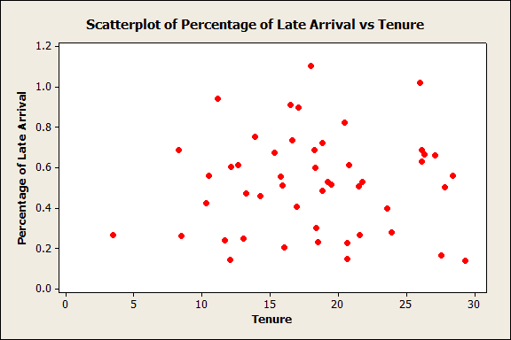
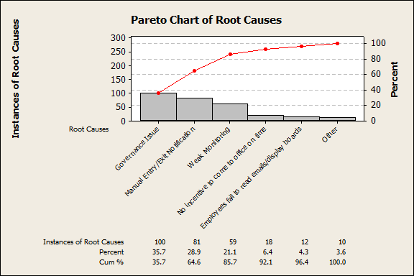
CASE STUDY
IMPROVING THE LATE ARRIVALS OF EMPLOYEES AT MATRIX CORP.
15th December
PROBLEM STATEMENT:
In the past 15 weeks, our on-time arrival rate is 10% i.e. over 90% of employees working at Matrix Corp. are arriving late to work. The scheduled work hours are for 8.5 hours, however, employees arrive late at work by over 2 to 3 hours on an average each day. This slashes their productivity by 48% and negatively impacts their morale. This also has a major impact on the customers of Matrix Corp as they unable to meet customer demands.
ROOT CAUSES IDENTIFICATION:
PROJECT GOAL:
Improve the on-time arrival rate from 10% to 75% for employees of Matrix Corp. by June 2018.
ACTIONS TAKEN:
Add a biometric or an automated swipe in/out mechanism
Create a robust governance from an automated mechanism to track, monitor and report late arrivals
Start sms service to all employees with their roster details
Ensure all supervisors come on time
Provide training to all supervisors to give feedback if their team members arrive late
PROJECT TEAM:
Project Champion: Sean Hirsch
Master Black Belt: Natalie Minghella
Black Belt: Anne Taylor
Green Belt: Skyler Kinnaman
Yellow Belt: Gosha Kutsenko
Project Team: Maria Garcia, Michael Smith, Mary Rodriguez & Robert Hernandez
PROJECT OUTCOME:
On-Time Arrival rate improved from 10% to > 90%
SIGMA VALUE OF THE LATE ARRIVAL RATE IMPROVED FROM 0.2 SIGMA TO 2.7 SIGMA

